Slide 1



FIRE AND SMOKE DETECTION SYSTEM
TEAM MEMBERS:
9
40
8
53
43
K R GOURINANDA
PRARTHANA R
KEERTHI PRATHAP
SIVAKRISHNA V
R SREERAG
1

Slide 2
INTRODUCTION
Fire safety is essential in modern environments due to the widespread use of electrical devices, machinery, and flammable materials. Since fires can occur unexpectedly and spread rapidly, early detection is crucial to reduce damage and protect lives.
With the advancement of Internet of Things (IoT) technology, smart systems can monitor environmental conditions in real time and respond automatically. This project develops an IoT-based fire and smoke detection system that triggers a local alarm and sends instant alerts to the user’s mobile phone. Compared to traditional standalone detectors, this approach enables remote monitoring, faster response, and improved overall safety.
2

Slide 3
LITERATURE REVIEW
TITLE
JOURNAL AND YEAR
LIMITATIONS
SOLUTIONS
International Journal of Advance Scientific Research & Engineering Trends, Volume 5, Issue 12, April 2021
Smoke Detection and Fire Safety System Using IoT
Incorrect sensor selection — MQ-7 gas sensor detects only carbon monoxide, not general smoke, causing unreliable fire detection.
Replace with MQ-2 gas sensor for broader detection of smoke and combustible gases, improving fire detection accuracy.
IoT Based Fire and Smoke Detection using Alarm and App Notification
International Journal of Innovative Research in Technology, Volume 12, Issue 8, January 2026
Overdependence on Wi-Fi — alerts fail if power, router, or network goes down during a fire.
Add SIM900A GSM/GPRS module for reliable SMS/call alerts even without Wi-Fi.
Add 18650 lithium-ion battery with IP5306 charging module to provide backup power and ensure uninterrupted safety monitoring.
Disaster & Development, Vol. 12, Issue 02, July–December 2023
No power failure strategy — system stops working when electricity fails during a fire.
Smart Fire Detection System Using IoT
3

Slide 4
OBJECTIVES
To design and implement a fire and smoke detection system using Arduino
To detect smoke using MQ2 gas sensor
To detect fire using infrared flame sensor
To continuously monitor environmental conditions in real time
To activate a buzzer when smoke or flame is detected
To send SMS alert using GSM SIM900A module
To automatically make a phone call during emergency
To provide quick warning to prevent fire accidents
To use separate power supply modules for reliable GSM operation
4

Slide 5
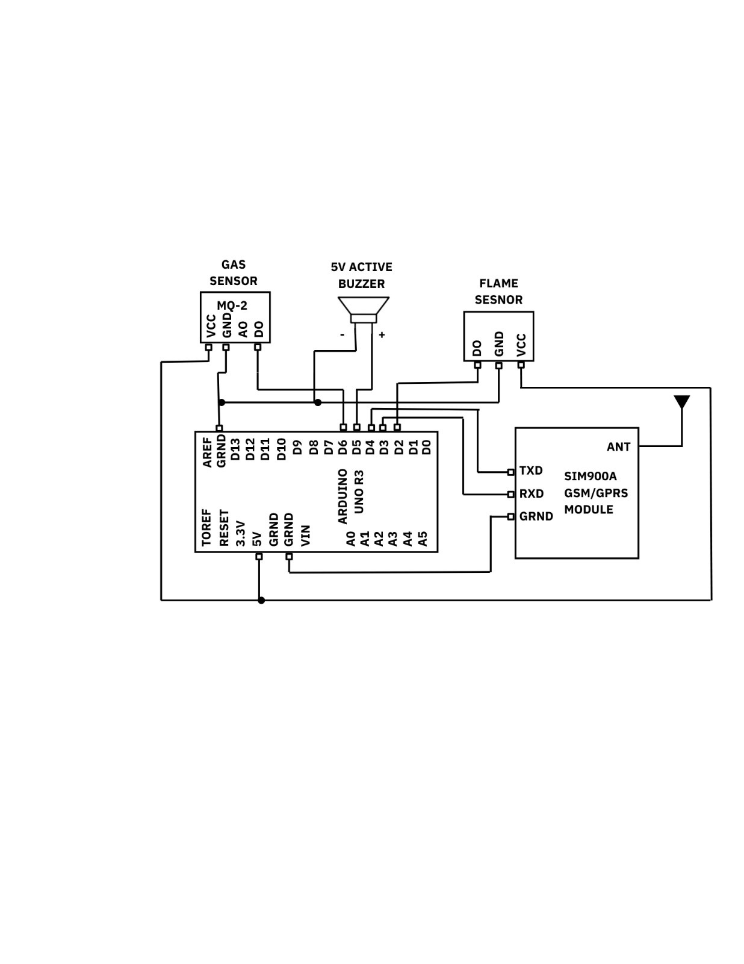
BLOCK DIAGRAM & COMPONENTS
Arduino Uno
MQ2 Smoke Sensor
Flame Sensor
GSM SIM900A Module
Buzzer
IP5306 Power Bank Module (for Arduino)
IP5306 Power Bank Module (for GSM)
1000µF Capacitor (for GSM power stabilization)
Lithium-ion Battery
Connecting Wires
Breadboard
5

Slide 6
METHODOLOGY
The system is built using an Arduino Uno as the main controller to process data from an MQ2 Smoke Sensor and a Flame Sensor. A SIM900A GSM Module is used to send SMS and call alerts, while a buzzer provides immediate local warning. Separate power supply and a capacitor ensure stable operation. The system continuously monitors the environment and detects abnormal conditions.
Smoke detection (MQ2)
Flame detection (IR)
Continuous monitoring
Buzzer alert
SMS & call alerts
No repeat alerts (flag)
Auto reset
6

Slide 7
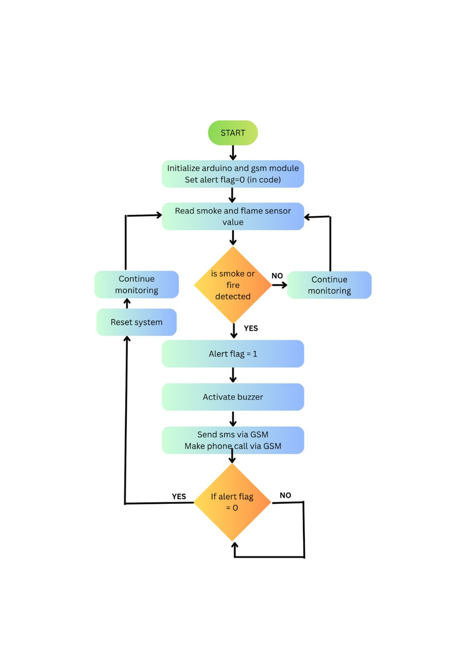
WORKING
System starts and initializes all modules
Sensors continuously monitor smoke and flame
Arduino checks for abnormal conditions
If detected, buzzer gives alert
GSM module sends SMS and call
System avoids repeated alerts using flag
Resets after condition becomes normal
7

Slide 8
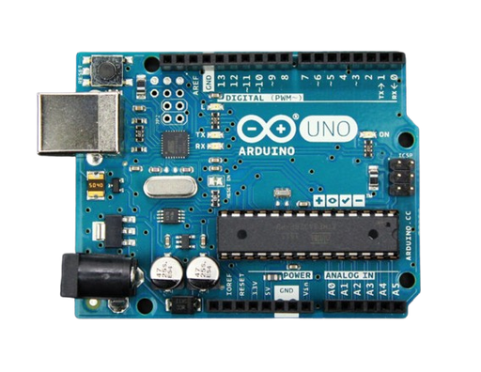
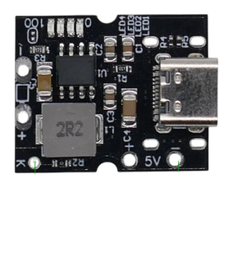
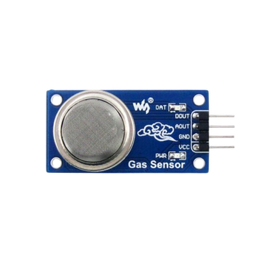
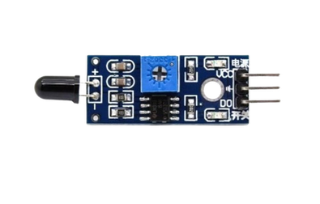



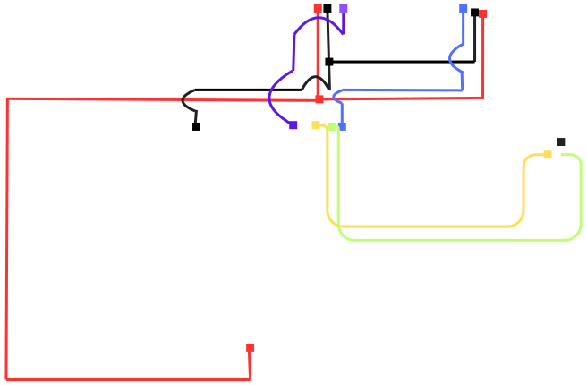
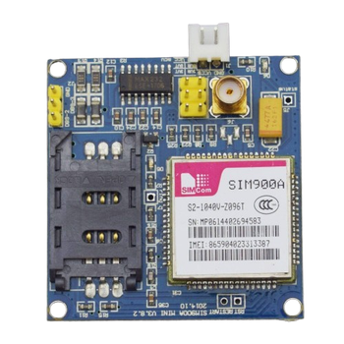
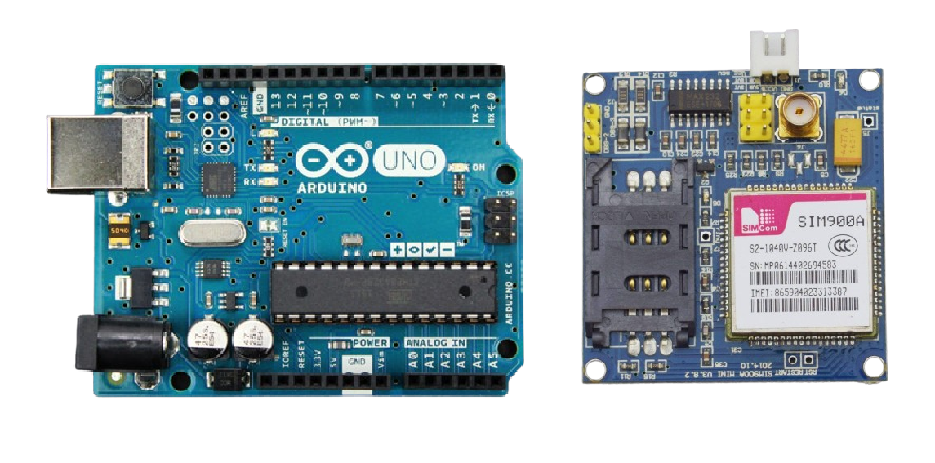


CIRCUIT DIAGRAM
8

Slide 9
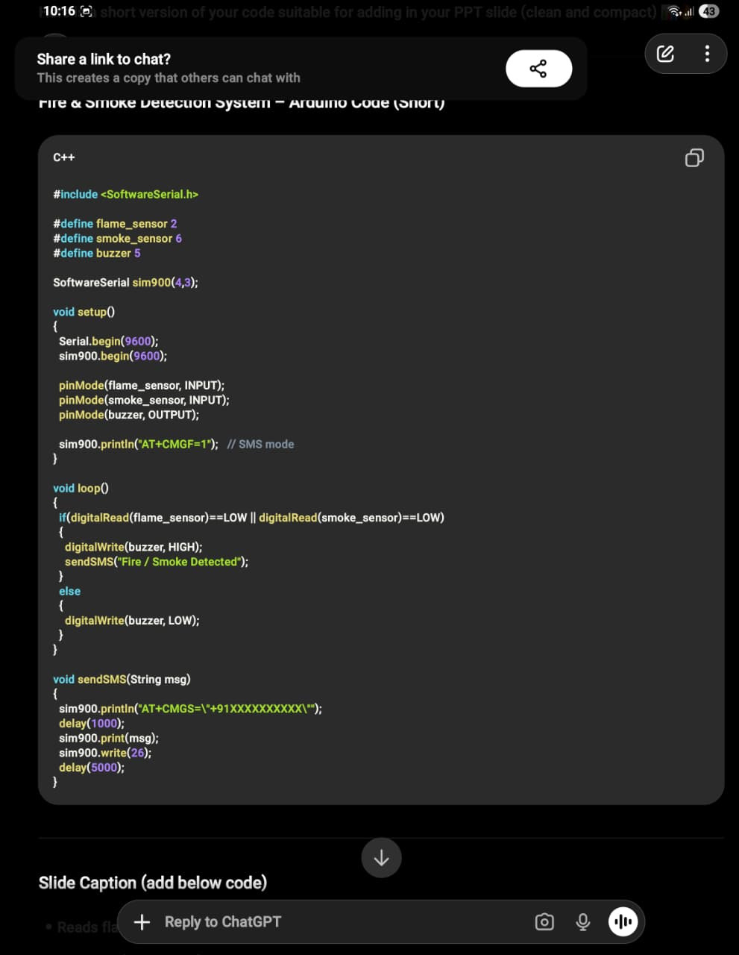
CODE
Initializes communication with GSM module
Sets sensor pins as input and buzzer as output
Reads flame and smoke sensor values
Checks for fire or smoke condition
Activates buzzer when danger is detected
Sends alert message using GSM module
Repeats process continuously in loop
Detailed code
9

Slide 10
TESTING PROCEDURE
Circuit connections verified before power ON
Power supply and GSM module checked
SIM inserted and network confirmed
GSM initialization verified via serial monitor
MQ2 Smoke Sensor tested with smoke
Flame Sensor tested with flame
Buzzer and GSM alerts verified for detection
SMS and call functionality confirmed
Alert flag checked to avoid repetition
System reset and continuous monitoring tested
10

Slide 11
APPLICATIONS
Fire detection in homes and residential buildings
Safety monitoring in offices and commercial spaces
Industrial fire and smoke detection systems
Laboratories and research centers
Warehouses storing flammable materials
Server rooms and electrical control panels
Schools and educational institutions
Kitchen safety monitoring systems
11

Slide 12
CONCLUSION
The fire and smoke detection system was successfully implemented using an Arduino Uno, along with an MQ2 Smoke Sensor and a Flame Sensor for accurate detection. The SIM900A GSM Module enabled real-time SMS and call alerts, while the buzzer provided immediate local warning. The system operates continuously, offering a low-cost, reliable, and easy-to-implement solution that helps in early fire detection and reduces potential hazards.
12

